Slide 1
Session 01 : Introduction To Android
Module 4.3 : Android

Slide 2
Learning Objectives
At the end of the session successful participants will be able to
Understand Android as mobile development platform
Understand basic of different components of Android

Slide 3
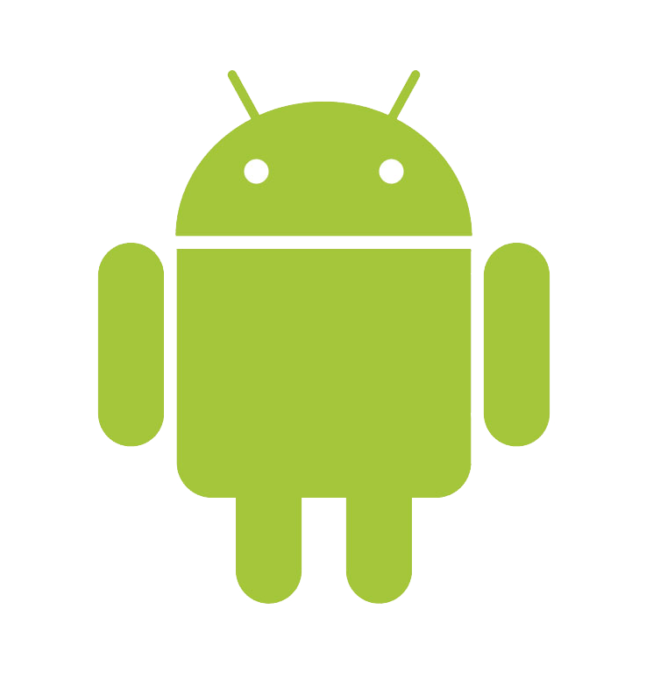
Introduction To Android Development
Android

Slide 4


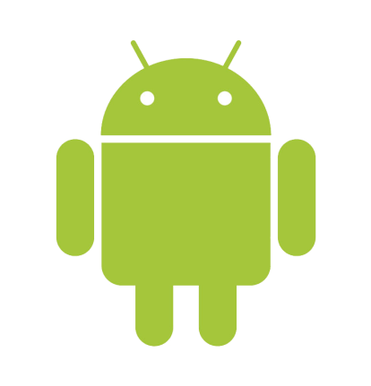
Introduction To Android Development
What is Android?
Android is an open-source software platform created by Google and the Open Handset Alliance.

Slide 5
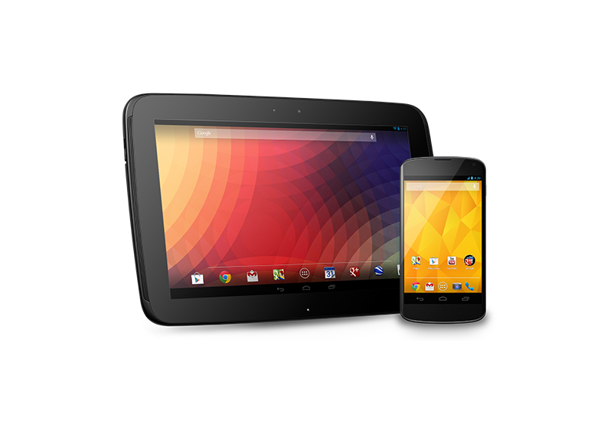
Introduction To Android Development
What is Android?
It is primarily used to power mobile phones.
It has the capability to make inroads in many other (non-phone) embedded application markets.

Slide 6
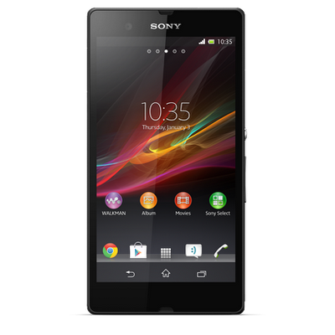
Introduction To Android Development
What is Android?
Android™ consists of a complete set of software components for mobile devices including:
An operating system
Middleware
Key mobile applications
a large market

Slide 7
Introduction To Android Development
What is Android?
Creators & Developers of Android
Nick Sears. Co-founder of Android
Steve Horowitz. Engineering Director
Dam Morrill. Developer
PeisunWu. Engineering Project Manager
Erick Tseng. Project Manager
IliyanMalchev. Engineer
Mike Cleron. Software Manager
Per Gustafsson. Graphics Designer.
Listen these people on:
http://www.youtube.com/watch?v=6rYozIZOgDk&eurl=http://www.android.com/about/&feature=player_embedded

Slide 8
Introduction To Android Development
What is Open Handset Alliance?
Open Handset Alliance™, a group of 47 technology and mobile companies have come together to accelerate innovation in mobile and offer consumers a richer, less expensive, and better mobile experience.

Slide 9
Introduction To Android Development
What is Open Handset Alliance?
Quoting from www.OpenHandsetAlliance.com page
Together we have developed Android™, the first complete, open, and free mobile platform.
We are committed to commercially deploy handsets and services using the Android Platform.

Slide 10
Introduction To Android Development
Open Handset Alliance Members
Operators | Software Co. | Commercialization | Semiconductor | Handset Manufacturer
China Mobile China Unicom KDDI Corp. NTT DoCoMo Sprint Nextel T-Mobile Telecom Italia Telefónica Vodafone Softbank … Ericsson | Ascender Corp. eBay Esmertec Google LivingImage NMS Comm. Nuance Comm. PacketVideo SkyPop SONiVOX … Borqs | Aplix NoserEngineering Astonishing Tribe Wind River Systems Omron Software … Teleca | Audience Broadcom Corp. Intel Corp. Marvell Tech. Group Nvidia Corp. Qualcomm SiRFTech. Holdings Synaptics Texas Instr. AKM Semicond. ARM AtherosComm ... EMP | ACER ASUS HTC LG Motorola Samsung ASUSTek Garmin HuaweiTech LG Samsung … Sony Ericsson Toshiba

Slide 11
Introduction To Android Development
Two Android Developers
Video http://www.youtube.com/watch?v=7Y4thikv-OM
showing Dave Bort and Dan Borstein, two members of the Android Open Source Project talk about the project.

Slide 12
Introduction To Android Development
The Android Platform
Android is a software environment built for mobile devices.
It is not a hardware platform.
Android Includes:
Linux kernel-based OS
A rich UI
Telephone functionality
End-user applications
Code libraries
Application frameworks
Multimedia support ...
We are committed to commercially deploy handsets and services using the Android Platform.

Slide 13
Introduction To Android Development
Android’s Context: Mobile Market Players
Mobile network operators want to lock down their networks, controlling and metering traffic.
Operators
Software Vendors
Device Manufacturers
Device manufacturers want to differentiate themselves with features, reliability, and price points.
Software vendors want complete access to the hardware to deliver cutting-edge applications.

Slide 14
Introduction To Android Development
The Maturing Mobile Experience
Not so long ago … | Today
Phone Pager PDA Organizer Laptop Portable music player No Internet access / limited access | Smartphone Laptop (perhaps!)

Slide 15
Introduction To Android Development
The Maturing Mobile Experience
2015 Smartphone should include:
Phone Pager PDA Organizer High Quality Camera (still & video) Portable music player PortableTV / Video Player / Radio Laptop Play Station GPS | Golf Caddy (ball retriever too) Book Reader (I don’t read, It reads to me) Car / Home / Office Key Remote Control (Garage, TV, …) Credit Card Cash on Demand Cook, house chores Psychologist / Mentor / Adviser ????

Slide 16

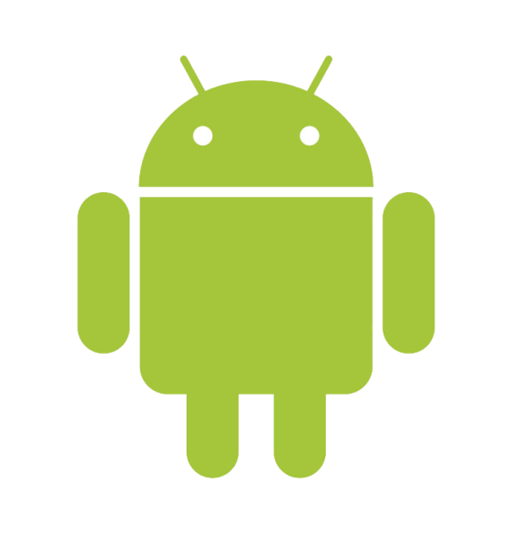
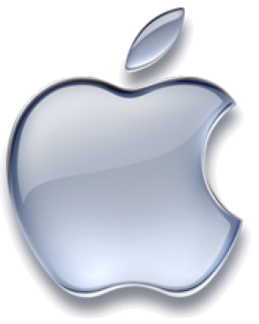

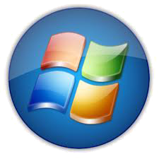


Introduction To Android Development
Android Competitors
Vs.

Slide 17
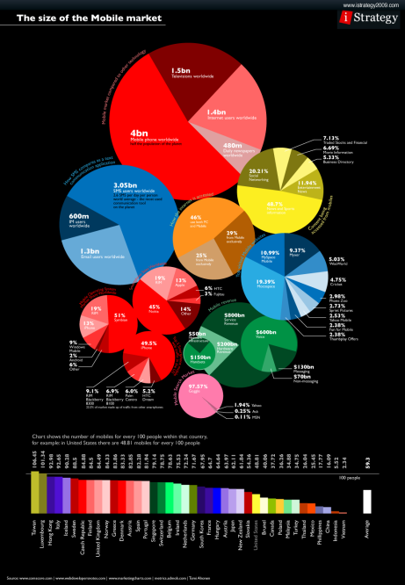
Introduction To Android Development
The Size of the Mobile Market
Click to open and refer the below image in detail: http://gizmodo.com/5489036/cellphone-overshare

Slide 18
Introduction To Android Development
Android Components (Stack)
The Android stack includes a large array of features for mobile applications.
It would be easy to confuse Android with a general purpose computing environment.
All of the major components of a computing platform are included.

Slide 19
Introduction To Android Development
Android Components
Application frame work enabling reuse and replacement of components
Dalvik virtual machine optimized for mobile devices
Integrated browser based on the open source WebKit engine

Slide 20
Introduction To Android Development
Android Components
Optimized graphics powered by a custom 2D graphics library; 3D graphics based on the OpenGL ES specification (hardware acceleration optional)
SQLite for structured data storage
Media support for common audio, video, and still image formats (MPEG4, H.264, MP3, AAC, AMR, JPG, PNG, GIF)

Slide 21
Introduction To Android Development
Android Components
GSM Telephony(hardware dependent)
Bluetooth, EDGE, 3G, and WiFi (hardware dependent)
Camera, GPS, compass, and accelerometer(hardware dependent)
Rich development environment including a device emulator, tools for debugging, memory and performance profiling, and a plugin for the Eclipse IDE

Slide 22
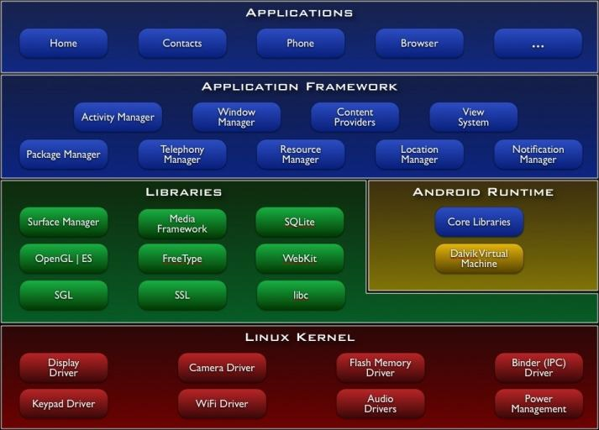
Introduction To Android Development
Android Components

Slide 23
Introduction To Android Development
Android Components
Presentation on Android Architecture http://www.youtube.com/watch?v=QBGfUs9mQYY
(13 Min.)
Presented By:
Mike Cleron, Google Corp.

Slide 24
Introduction To Android Development
Android Components
Presentation on Applications Life Cycle
http://www.youtube.com/watch?v=fL6gSd4ugSI&feature=channel
(8 Min.)
Presented By:
Mike Cleron, Google Corp.

Slide 25
Introduction To Android Development
Android Components
Presentation on Android’s API
http://www.youtube.com/watch?v=MPukbH6D-lY&feature=channel
(7 Min.)
Presented By:
Mike Cleron, Google Corp.

Slide 26
Introduction To Android Development
Android Components
Presentation on Introduction to Android
http://www.youtube.com/watch?v=x1ZZ-R3p_w8
(52 Min.)
Presented By:
Jason Chen – Google
At Google Developer Conference
San Francisco - 2008

Slide 27
Introduction To Android Development
Android Application Framework
Presentation on Android Application Framework
https://sites.google.com/site/io/inside-the-android-application-framework
(52 Min.)
Presented By:
Dan Morrill – Google
At Google Developer Conference
San Francisco -2008

Slide 28
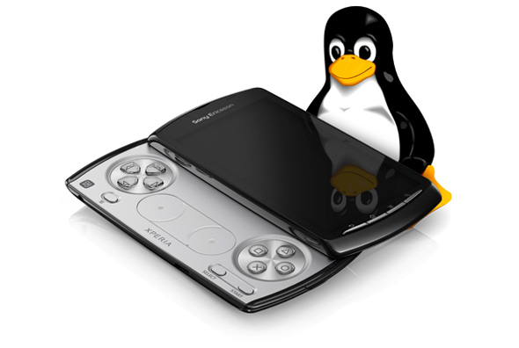
Introduction To Android Development
Why Use Linux For The Phone?

Slide 29
Introduction To Android Development
Why Use Linux For The Phone?
Linux kernel is a proven core platform.
Reliability is more important than performance when it comes to a mobile phone, because voice communication is the primary use of a phone.
Linux can help meet this requirement.

Slide 30
Introduction To Android Development
Why Use Linux For The Phone?
Linux provides a hardware abstraction layer, letting the upper levels remain unchanged despite changes in the underlying hardware.
As new accessories appear on the market, driver scan be written at the Linux level to provide support, just as on other Linux platforms.

Slide 31
Introduction To Android Development
Dalvik Virtual Machine
User applications, as well as core Android applications, are written in Java programming language and are compiled into byte codes.
User Applications
Java
Core Android Applications
Java Compiler
Byte Code

Slide 32
Introduction To Android Development
Dalvik Virtual Machine
Android byte codes are interpreted at runtime by a processor known as the Dalvik Virtual Machine.
User Applications
Java
Core Android Applications
Java Compiler
Interpreted by Dalvik Virtual Machine
Byte Code

Slide 33
Introduction To Android Development
Why Another Virtual Machine?
Android byte code files are logically equivalent to Java byte codes, but they permit Android to
Run its applications in its own virtual environment that is free from Sun’s licensing restrictions and
An open platform upon which Google, and potentially the open source community, can improve as necessary

Slide 34
Introduction To Android Development
Dalvik Virtual Machine
Presentation on Dalvik Virtual Machine
http://www.youtube.com/watch?v=ptjedOZEXPM
(61 Min.)
Presented By:
Dan Borstein – Google
At Google Developer Conference
San Francisco - 2008

